Slide 1

Snowflake Data Load
Bulk Load

Slide 2
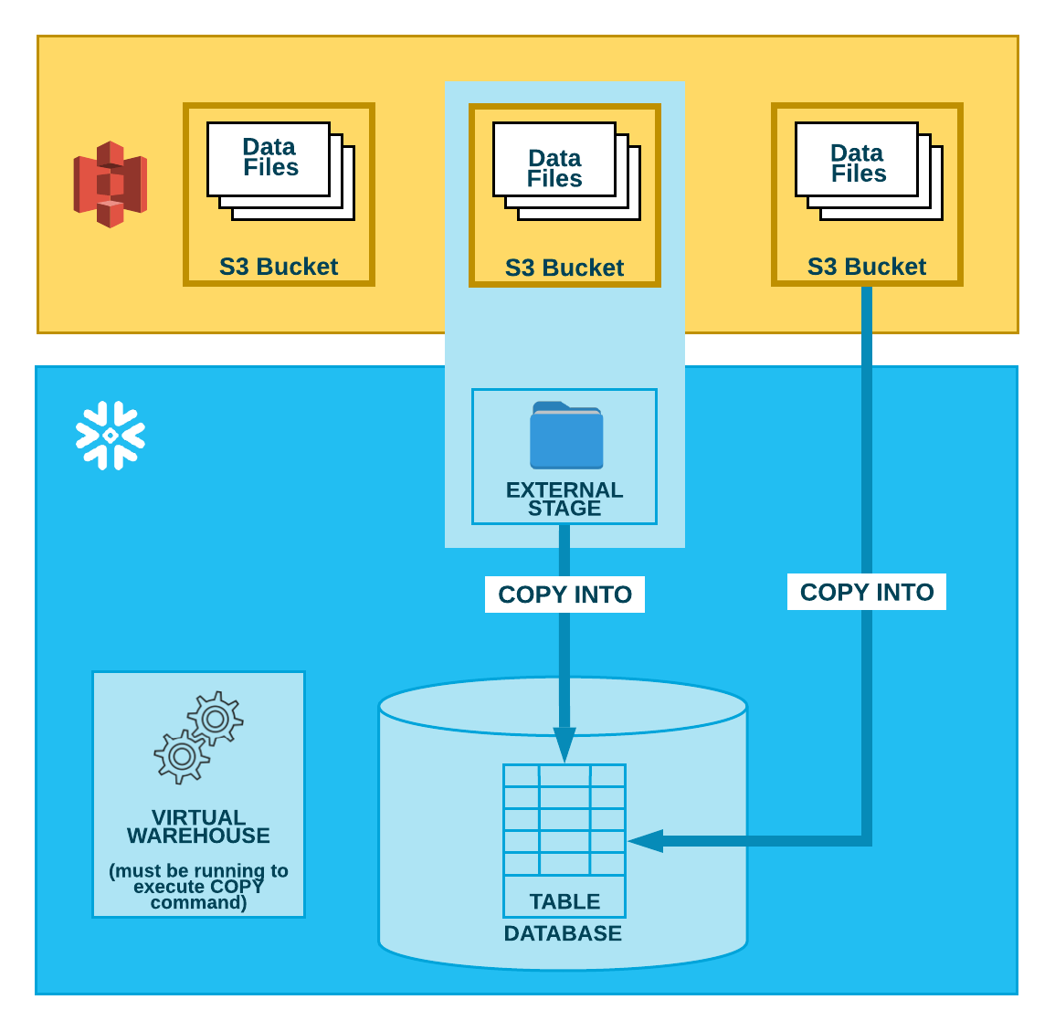
Recap External Data loading

Slide 3
External Data Load
Data load from Structured data
Data load from semi-structured data
Data load from public s3 bucket
Data load from s3 bucket using secret key and access key
Data load using storage integration

Slide 4
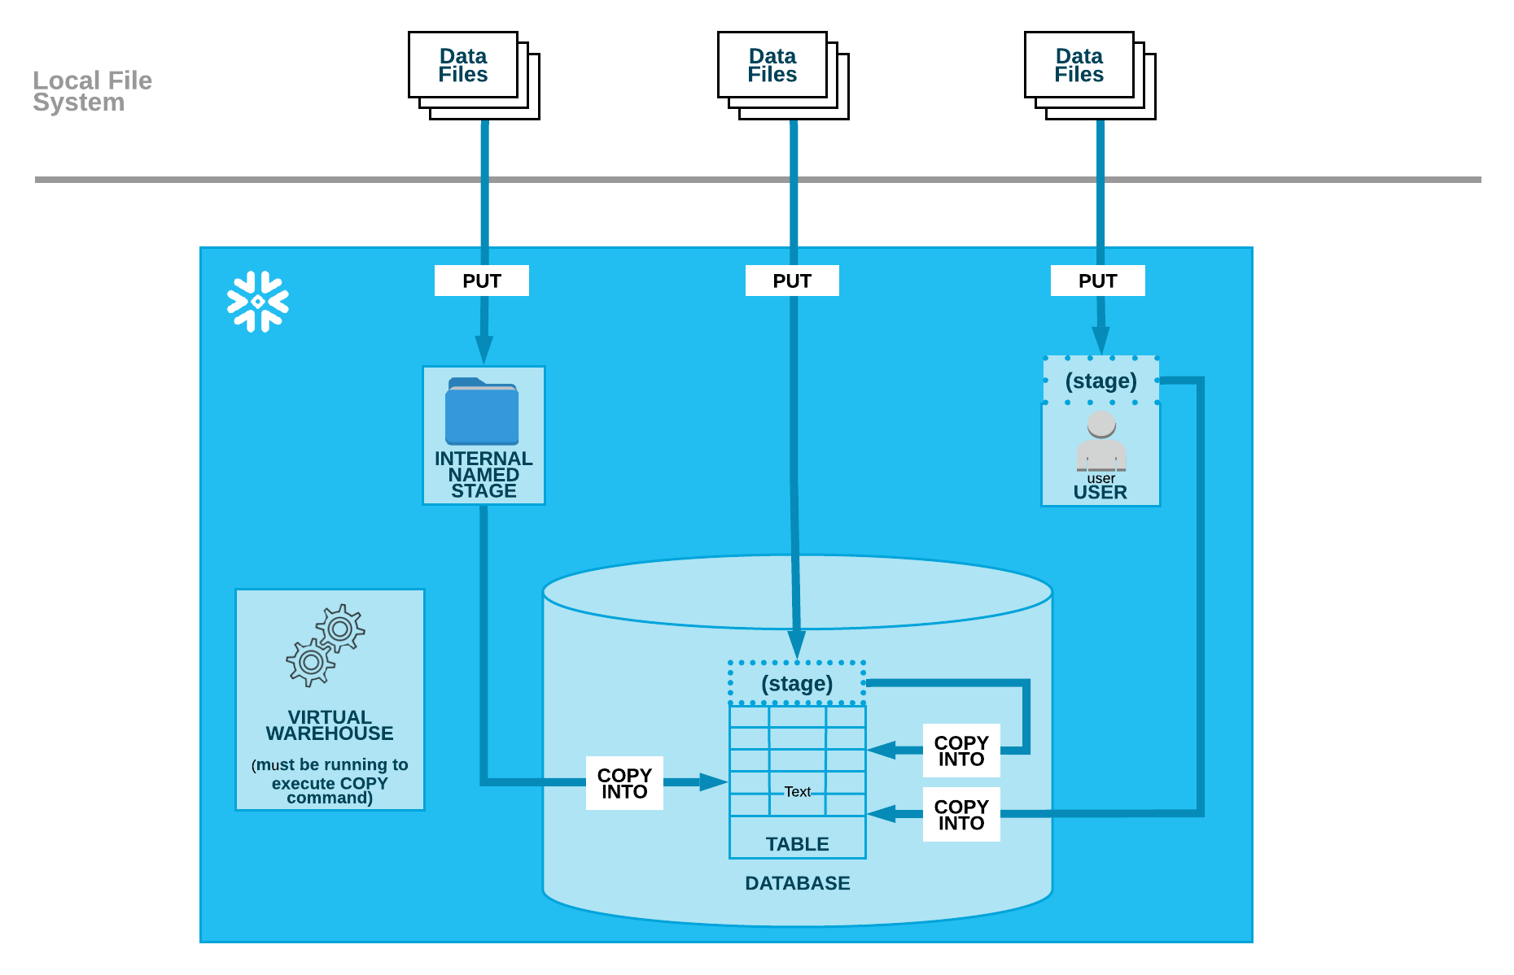
Loading data from local file system

Slide 5
Creating Internal Stages – USER STAGE
Staging the Data Files
User Stage
User stages are referenced using @~; e.g. use LIST @~ to list the files in a user stage.
Unlike named stages, user stages cannot be altered or dropped.
User stages do not support setting file format options. Instead, you must specify file format and copy options as part of the COPY INTO <table> command.
E.g. PUT file://C:\data\data.csv @~/staged;
LIST @~;
COPY INTO mytable from @~/staged FILE_FORMAT = (FORMAT_NAME = 'my_csv_format');

Slide 6
Creating Internal Stages – TABLE STAGE
Staging the Data Files
Table Stage
Table stages have the same name as the table; e.g. a table named mytable has a stage referenced as @%mytable.
Unlike named stages, table stages cannot be altered or dropped.
Table stages do not support transforming data while loading it (i.e. using a query as the source for the COPY command).
E.g. PUT file://C:\data\data.csv @%mytable;
LIST @%mytable;
COPY INTO mytable FILE_FORMAT = (TYPE = CSV FIELD_DELIMITER = '|' SKIP_HEADER = 1);

Slide 7
Creating Internal Stages – NAMED STAGE
Staging the Data Files
Named Stage
Users with the appropriate privileges on the stage can load data into any table.
Because the stage is a database object, the security/access rules that apply to all objects apply. The privileges to use a stage can be granted or revoked from roles. In addition, ownership of the stage can be transferred to another role.
E.g. PUT file://C:\data\data.csv @my_stage;
LIST @my_stage;
COPY INTO mytable from @my_stage;

Slide 8
Removing Internal staged Files
Files that were loaded successfully can be deleted from the stage during a load by specifying the PURGE copy option in the COPY INTO <table> command.
Load files from a table’s stage into the table and purge files after loading. By default, COPY does not purge loaded files from the location. To purge the files after loading:
that all files successfully loaded into the table a Set PURGE=TRUE for the table to specify re purged after loading:
ALTER TABLE mytable SET STAGE_COPY_OPTIONS = (PURGE = TRUE);
COPY INTO mytable;
You can also override any of the copy options directly in the COPY command:
COPY INTO mytable PURGE = TRUE;
After the load completes, use the REMOVE command to remove the files in the stage.
REMOVE @mystage/path1/subpath2;
REMOVE @%orders;
RM @~ pattern='.*jun.*';

Slide 9
DIRECTORY TABLES
A directory table is an implicit object layered on a stage (not a separate database object) and is conceptually similar to an external table because it stores file-level metadata about the data files in the stage. A directory table has no grantable privileges of its own.
This example retrieves all metadata columns in a directory table for a stage named mystage:
SELECT * FROM DIRECTORY(@mystage);

Slide 10
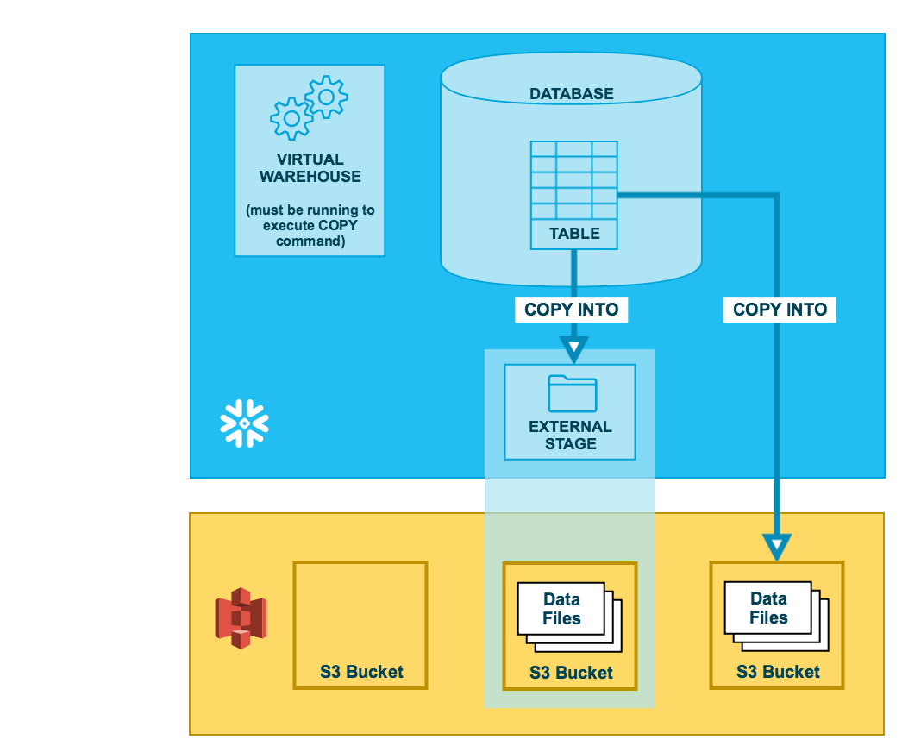
DATA unloading – External Stage

Slide 11
DATA unloading – External Stage
COPY via named stage:
CREATE OR REPLACE STAGE my_ext_unload_stage URL='s3://unload/files/'
STORAGE_INTEGRATION = s3_int
FILE_FORMAT = my_csv_unload_format;
COPY INTO @my_ext_unload_stage/d1 from mytable;
Unloading Data Directly into an S3 Bucket
COPY INTO s3://mybucket/unload/ from mytable storage_integration = s3_int;

Slide 12
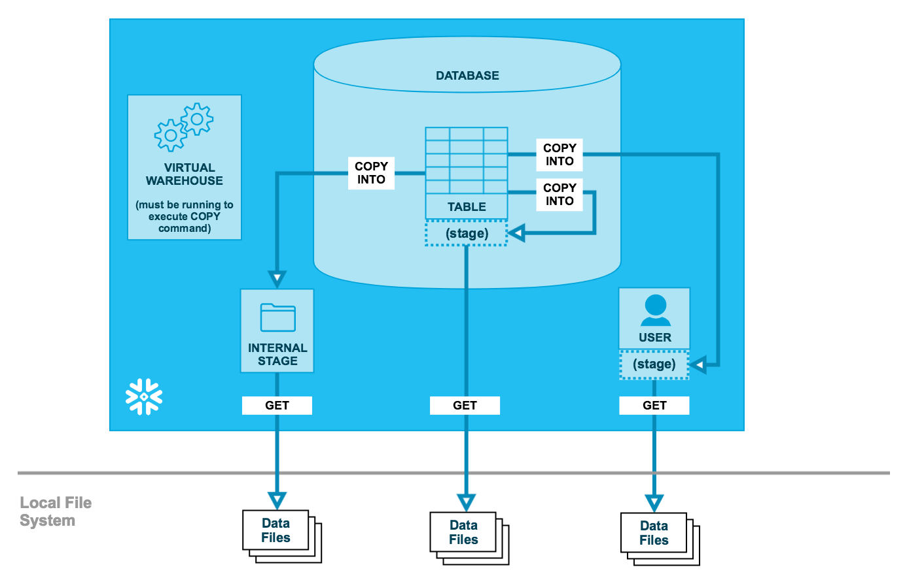
DATA Unloading – Via internal Stage

Slide 13
DATA Unloading – Via internal Stage
Unloading Data to a Named Internal Stage
CREATE OR REPLACE STAGE my_unload_stage
FILE_FORMAT = my_csv_unload_format;
COPY INTO @mystage/unload/ from mytable;
GET @mystage/unload/data_0_0_0.csv.gz file://C:\data\unload;
Unloading data via table stage
COPY INTO @%mytable/unload/ from mytable FILE_FORMAT = (FORMAT_NAME = 'my_csv_unload_format' COMPRESSION = NONE);
GET @%mytable/unload/data_0_0_0.csv file://C:\data\unload;
Unloading Data to Your User Stage
COPY INTO @~/unload/ from mytable FILE_FORMAT = (FORMAT_NAME = 'my_csv_unload_format' COMPRESSION = NONE);
GET @~/unload/data_0_0_0.csv file://C:\data\unload;

